Slide 1
Healthcare Intelligence: Turning Data into Knowledge
Team 4
Venkata Vamsi Krishna Bhuvanam – 5
Priyadarsini nidadavolu – 26
Bhulakshmi makkena – 16
Tej Kumar Yentrapragada – 48

Slide 2
Introduction
US Government major concern – Healthcare System.
Currently US Healthcare System investing in variety of technologies like sensors, communication technologies and data centers.
These rapid advancements of health IT have led to Big Data environments in hospitals.
In general, Healthcare providers lack of decision-support tools that will help in
Handling large-scale healthcare records
Optimizing operational dynamics.
Extracting the certain knowledge of patient health condition
Provision of more personalized and effective services.

Slide 3
Introduction (contd.)
Research Initiatives: Recent years government invested in lot of research by using a data-centric approach.
The primary research is to increase and enhance the quality of services to public in emergencies.
US National Science Foundation found that the data mining research in health industry helped a lot in
Improving Core Technologies
Technologies for Big Data Science & Engineering
Smart and Connected Health

Slide 4
Topics of Issue
Based on various Big Data Analytics and knowledge discovery, we have different challenges.
This issue talks about 4 topics in Health Care Services:
Empowering Excellence of Care by Radiology Informatics.
Opportunities for Operations Research in Medical Decision Making.
Diagnostic Network Modelling of Neural Connectivity Using Functional Magnetic Resonance Imaging.
Spatial Clustering in Public Health: Advances and Challenges.

Slide 5
Empowering Excellence of Care by Radiology Informatics
Usually Radiology uses various imaging techniques for diagnosing, monitor and treat diseases.
Jing Le and her colleagues present Three major areas of informatics in Radiology.
Dose Index Tracking – Helped to track down the radiation levels for each patient – This helps to treat patient in real-time and reporting and alarm notifications are really helpful.
Mobile application – Developed for radiology image viewing to reduce time to treatment.
Big Data Analytics & Machine Learning – Helped for finding inter- and intra-tumor in images there by devising plan for treatment specifically.

Slide 6
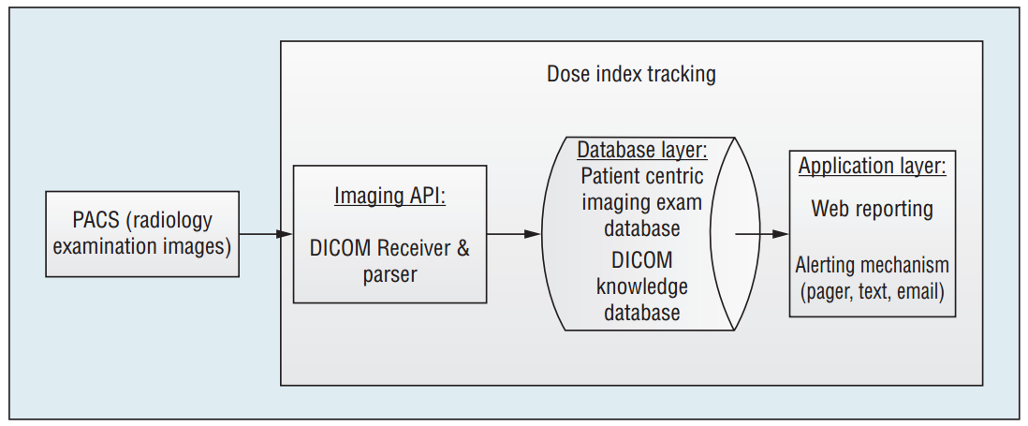
DIT: Supporting Quality Assurance in Radiology Practices
Figure 1. A schematic view of Dose Index Tracking (DIT). This enterprise-wide information system technology can automatically track and monitor cumulative radiation doses for each patient and support real-time query, reporting, and alarm notification if dose limit guidelines are exceeded. DICOM stands for Digital Imaging and Communications in Medicine.

Slide 7
DIT (contd.)
Even though Radiology is used to find major diseases like Cancer, Stroke, Heart Attack etc., extensive exposure to radiation could be dangerous.
This Dose Index Tracking will help the doctor/health service provider to track on the radiation levels while diagnosing the disease.
Real-time calculations on radiation – helps to improve reaction time if anything goes wrong.
Radiology Picture Archiving and Communication Systems and Digital Imaging and Communications in Medicine receiver accept series of images and a knowledge base is created with standards noted in DICOM.
Based on this a web reporter and automated alert/messaging service will help doctors for effective treatment.

Slide 8
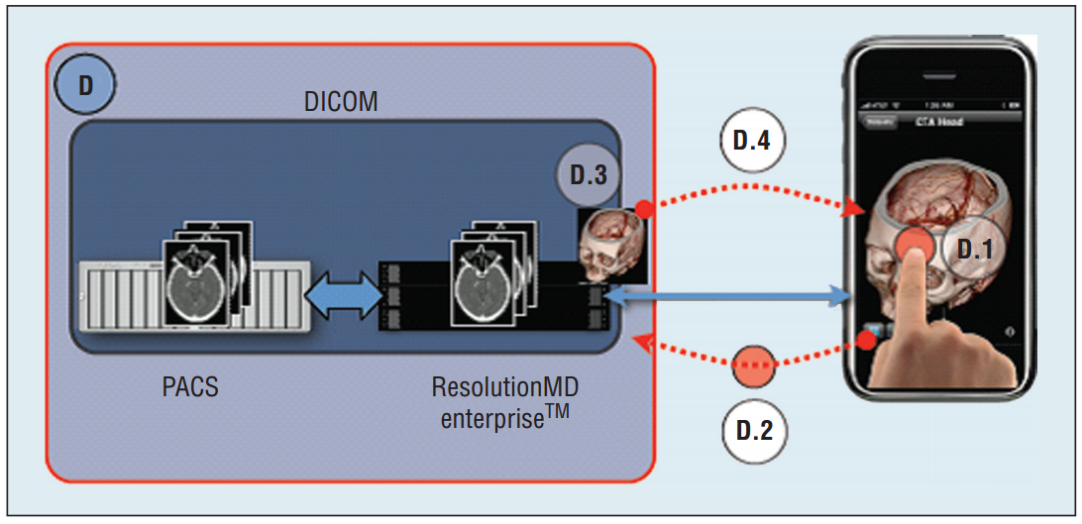
Resolution MD: A Mobile App for Imaging Accessibility
Figure 2. ResolutionMD architecture to support interactive image viewing on mobile devices. This figure is adapted from related work.

Slide 9
Resolution MD (contd.)
Mobile devices like Android and iOS smartphones are most common technologies in modern society which we use in daily life.
Many doctors carry one with them.
An application in their smartphone will help them to track the patient condition which will help diagnostic process.
A workstation helps to integrate all the images from PACS and create an interactive 3D visualization.
Sensitive private information will not be saved on mobile device, where session idle time-out and clearing volatile storage helps solving the problem.

Slide 10
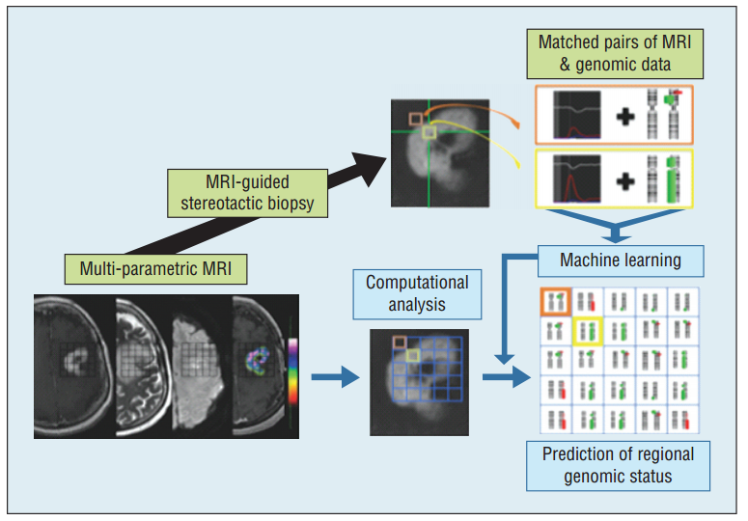
Imagenomics: Empowering Personalized Radiology Treatment
Figure 3. An illustration of imagenomic research. The research aims to use imaging to characterize inter- and intra-tumoral genomic diversity and inform more effective diagnosis and individualized treatment for each patient.

Slide 11
Imagenomics (contd.)
Imagenomics research helps to find inter and intra tumor genomic diversity.
Like in above two approaches based on series of images, a pattern will be created and matched with series of images of same patient – which helps to find changes in mass of tumors.
By matching MRI images with past patients, using some machine learning techniques, machine will predict the possible genomic issues in certain regions.
This approach is proven to be more effective and more individualized treatment is given to patient, instead of giving same kind of treatment to different types of cases.

Slide 12
Medical Decision Making
It’s a discipline which provides an approach to solve the decision making problems in healthcare.
Why MDM is powerful ?
It uses quantitative models hence it leads to cost effective decision making in Healthcare.
Developing a high performance medical data collection in order to provide better access to the relevant medical data.
A high level preventable medical errors, to focus on several national reports showed the importance of effective decision making.

Slide 13
Operations Research
Healthcare providers often reply on ad-hoc and heuristic decision making strategies.
What in case of uncertain factors? OR
OR uses advanced analytical methods – Better decision making.
OR enables realistic modelling of complex MDM problems.
OR tools are used for sequential decision making. Eg . Markov Decision Process.

Slide 14
Successful OR applications
An article by Jagpreet – Based on MDP model, a patient undergoing screening mammography must be sent for biopsy based on mammographic features and demographic risk factors.
Analytically and numerically, it is concluded that the probability threshold for biopsy is higher in older women than younger women.
The second article by Turgay Ayer, developed a personalized mammography screening schedule which utilizes prior screening history and personal risk characteristics of women .
Thirdly, an article based on the optimization concludes that an approximate of 22% in overall cost is saved by using the optimized thresholds.

Slide 15
Contd.
Successful research in decision making might need several themes to be considered.
The better approach is to select a problem for which a solution will have a substantial impact.
The problem need to selected by contacting the medical and healthcare professionals.
There are several problems in MDM that may be of interest to operation researchers who are interested in healthcare applications.
Personalization of screening and treatment, quantitative modelling of patient behavior, optimal communications etc are few.

Slide 16
Contd.
Personalized medicine – It aims to determine the patient specific assignment of healthcare solutions based on the persons unique clinical, genetic and environmental conditions.
However, this personalized medicine complicates the treatment process.
Quantitative Models – As it takes the quantitative models to accurately characterize the patient behavior, it gives a better understanding about MDM hence there can be a treatment success.
Optimizing Communication – Its been a challenging problem, among the diverse practitioners which can be overcome using OR tools.

Slide 17
Diagnostic Network Modeling of Neural Connectivity Using Functional Magnetic Resonance Imaging
Functional magnetic resonance imaging (fMRI) is a non-invasive neuroimaging tool that is used in both clinical and scientific settings to investigate brain function.
fMRI has emerged as an approach to study the large-scale connectivity underlying brain diseases and to investigate how the diseases alter and/or disrupt brain function

Slide 18
Network Modeling of Functional Connectivity MRI (fcMRI)
Used to capture statistical dependencies of temporally correlated neurophysiological events.
These dependencies are then mapped as patterns of connectivity across and between functional networks
And in turn to link the connectivity patterns to information about organizational properties of neural systems
Applied to fMRI data collected during task-evoked “activation” and during the unengaged, taskfree resting state in order to assess clinical disorders and cognitive behaviors.

Slide 19
Functional Localization: Defining Functional Nodes
Seed-based approach: in which the time-varying fMRI signal within a specific, spatially defined voxel is correlated with the time series from voxels across the entire brain.
Independent component analysis (ICA):a statistical approach that can decompose rs-fMRI data into non-overlapping spatial components.
Anatomical parcellation: in which the brain is segmented into established, known regions of interest (ROIs), typically based on standard anatomical atlases.
Functional parcellation: which defines 264 ROIs as small spheres centered upon ROI coordinates

Slide 20
Functional Connectivity: Inter-Nodal versus IntraNodal Connectivity
The blood-oxygen level dependent (BOLD) signal can be used to monitor changes in blood flow in fMRI.
Inter-nodal connectivity is defined by a correlated BOLD signal between spatially distinct nodes.
An individual node is usually comprised of multiple voxels and the time averaged fMRI signal across all the voxels with the node is used to determine inter-nodal connectivity.
Intra-nodal connectivity (IRC) models connectivity within each ROI as a full graph and measure an average of all pair-wise correlation between BOLD time courses of all possible node pairs

Slide 21
Asymmetrically Disrupted Local Connectivity in Epilepsy
Temporal lobe resection has emerged as the standard care of treatment for the patients with refractory epilepsy
fcMRI is a non-invasive neuroimaging tool that could provide a distinct advantage in mapping the epileptic network and identify the epileptogenic zone.
The concept of asymmetry of local functional connectivity was investigated to capture anomalous patterns that are relevant to dysfunctional alterations in epilepsy and in turn identify the epileptogenic zone.
A ratio of IRC in the left hemisphere ROI to the connectivity in the right hemisphere ROI was proposed.

Slide 22
Lost Connectivity in Alzheimer’s Disease
rs-fMRI may be used to characterize neurodegenerative brain diseases such as Alzheimer’s disease (AD).
Cognitive decline in AD may result from the reduced ability of networks to reconfigure themselves.
Used of link community method to extract communities in rs-fMRI data from both AD patients and normal controls.
The link weights between these ROIs were quantified using a Pearson correlation between averaged BOLD time courses of voxels within individual ROIs

Slide 23
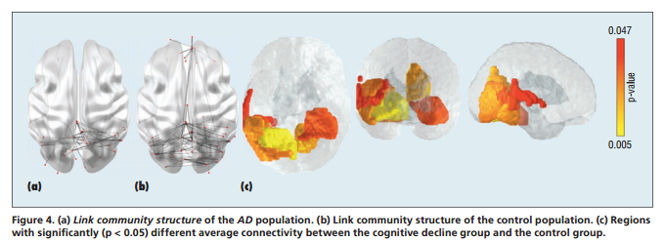
Reduced Connectivity in Cognitive Decline
Evidence suggests that reduced functional connectivity of large-scale networks as defined by rsfMRI is associated with loss of executive function and reductions in overall cognitive processing speed.
An investigation on the association between local connectivity and executive function decline in healthy aging.

Slide 24
Challenges
Two main steps of network modeling are
Identify functional nodes
Quantify functional connectivity.
The resulting brain connectivity model has to be interpretable in neurophysiological terms, and the network components must be reliable, reproducible, and robust across individuals in the testing population.

Slide 25
Spatial Clustering in public health : Advances and Challenges
Public Health surveillance aimed at time detection and prevention of various types of adverse health events has received much attention recently.
We should have a reliable public health surveillance system.
However health data is often collected across different geographic locations.
It’s important to take spatial information, because environmental factors could be important in some diseases.

Slide 26
Recent Advances in Spatial Clustering
There are two main tasks in identifying the disease clusters in a geographical region.
To test whether there are any patterns in data in early stages.
To pinpoint which subsets of data records have been affected by those patterns.
We have several categories of spatial clustering Spatial scan , Graph-based , false discovery rate based.

Slide 27
Spatial Scan Method
It is one of the most widely used tool for testing Spatial clusters of a disease
The goal of this is to search over a given set of spatial regions and find if there’s any spatial regions for which the counts are higher than expected.
We use randomization testing to determine the most likely cluster.
By using spatial scan statistics we need to pre specify the scanning window.

Slide 28
Graph Based Clustering
Due to effective data representation this approach has become dominant.
The simplest graph based clustering based algorithm is k-means.
It requires user to provide a number of clusters.
Among various graph based clustering methods minimum spanning tree has been extensively used by limiting to health.

Slide 29
Cluster Design using MST
First construct MST over given data set.
Remove inconsistent edges to create connected components.
We have different algorithms to remove inconsistent edges. Longest MST-edges , Maximizing/minimizing degree of vertices , Maximizing the overall standard deviation , maximizing the coefficient of variation using divide and conquer.

Slide 30
False Discovery Rate-based clustering method
It is aimed at identifying the locations of multiple clusters with arbitrary shapes.
FDR is used for controlling the type I error while testing multiple hypotheses.
One of the recent application is to test for presence of spatial signals in functional magnetic resonance imaging data.
It can be generally defined as proportion of clusters that are falsely declared among all declared clusters.

Slide 31
Challenges
Robust clustering algorithms in the presence of model ucertainty.
Multivariate spatial clustering.
Spatiotemporal clustering.
Sensitivity and accuracy.

Slide 32


Slide 33


